Slide 1
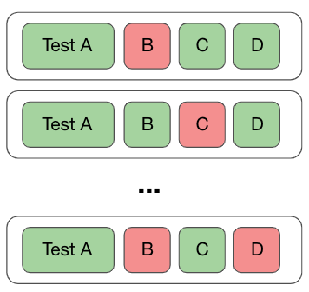
A Combined Approach to Detect Flaky Tests
Haya Samaana
Khaled Badran

Slide 2


Introduction
Test Vocabulary
Test Smells

Slide 3
Approach
Collect Flaky Tests
Extract Test Smells
Extract Vocabulary
Train and Test a Classifier
Analyze the Results

Slide 4

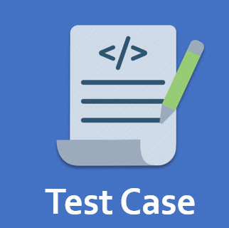
Collect Flaky Tests
Python projects
5719 Test Cases

Slide 5

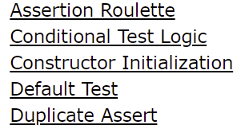
Extract Test Smells
Download the test files
PyNose for test smell extraction
20 different test smells
Notes:
- Explain test smells

Slide 6

Extract Vocabulary
Extract Test Body
Remove Stop Words
Tokenize

Slide 7




Train and Test a Classifier
Binary
Random Forest
Mode = TF-IDF
# words = 2000
# trees = 100
…
10 folds cross validation
Count
TF-IDF
Frequency
Notes:
- Random forest which takes as input both the vocabulary of the tests and the test smells as well

Slide 8
Analyze the Results
Flaky
Not Flaky
Precision
Recall
5%
95%
F1-Score

Slide 9
Analyze the Results
Flaky
Not Flaky
Precision
Recall
5%
95%
F1-Score

Slide 10
Analyze the Results
Flaky
Not Flaky
Macro Precision
Macro Recall
5%
95%
Macro F1-Score

Slide 11
Results
Macro Precision
Macro Recall
Macro F1-Score

Slide 12
Conclusion
Micro Precision
Micro Recall
Micro F1-Score
Adding test smells to the vocabulary information does not provide a substitutional improvement to the classifier.

Slide 13

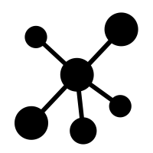

Train and Test a Classifier
Different textual presentation approaches ("binary", "count", "tfidf", "freq“)
Random forest model
Find the best configuration
Use 10 folds cross-validation
chatbot

Slide 14

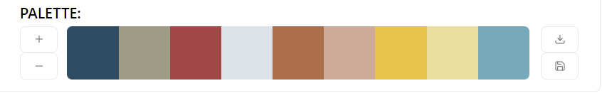
Train and Test a Classifier
Binary
Random Forest
Mode = TF-IDF
# words = 2000
# trees = 100
…
10 folds cross validation
Count
TF-IDF
Frequency

Slide 15
Notes:
To do so we first download all of SOF
1- We use SOF to understande the challenges of chatbot development as it is the most prominent Q&A website where developers share their experience that has millions of users, and posts, Speak about downloading the dump
2- Next we start by extracting all posts from the dataset that has a tag chatbot. On SOF Posts are typically tagged by their authors with commonly used tags that present the theme of the question or discussion which improve the posts’ visibility and chances of being answered
3- To expand our dataset by adding more chatbot related postsWe extract all the tags that coexist with the chatbot tag from those posts the resulted from the second step → speak about the result
4- However, we noticed that some tags could add noise such as Java and C# and the posts of such tags can contain posts that are unrelated to chatbots
Therefore, in the next step we removed those tags and we ended up having 22 chatbot related tags

Slide 16
Train and Test a Classifier
Binary
Random Forest
Mode = TF-IDF
# words = 2000
# trees = 100
…
10 folds cross validation
Count
TF-IDF
Frequency

